Slide 1
4 methods of solving recursions
Unrolling (substitution)
Guess & prove
Recursion Tree
Master Theorem

Slide 2
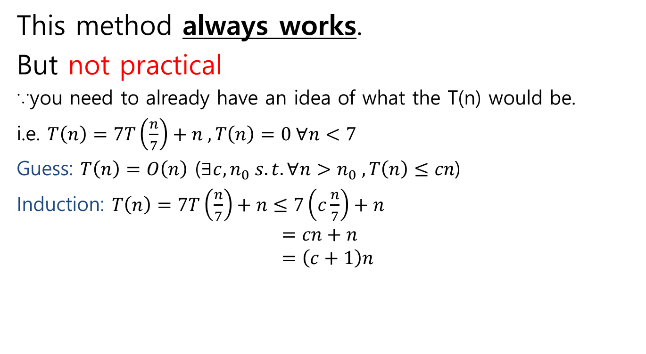
2. Guess & Prove
This method always works.
But not practical
∵you need to already have an idea of what the T(n) would be.
i.e. $T\left(n\right)=7T\left(\frac{n}{7}\right)+n , T\left(n\right)=0 ∀n<7$
Guess: $T\left(n\right)=O\left(n\right)$ ($∃c,n_{0} s.t. ∀n>n_{0} ,T\left(n\right)≤cn$)
Induction: $T\left(n\right)=7T\left(\frac{n}{7}\right)+n≤7\left(c\frac{n}{7}\right)+n$ $$=cn+n \\ =\left(c+1\right)n$$
↑Base case
constant changed from c to c+1
∴guess is incorrect

Slide 3

2. Guess & Prove
New guess: $T\left(n\right)=O\left(n\log{n}\right)$
Induction: $T\left(n\right)=7T\left(\frac{n}{7}\right)+n≤7\left(\frac{n}{7}\log_{7}{\frac{n}{7}}\right)+n$ $$=n\log_{7}{\frac{n}{7}}+n \\ =n\left(\log_{7}{n}−1\right)+n \\ ≤n\log_{7}{n}+n=O(n\log{n})$$
∵ $n\log{n}$ grows asymptotically faster than $n$

Slide 4



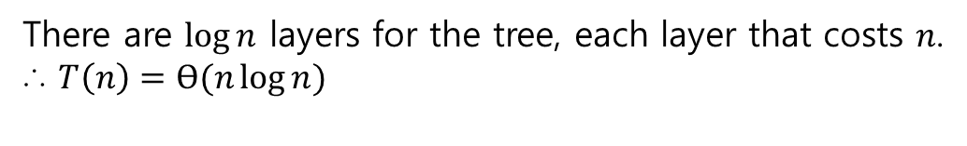







3. Recursion Tree
Draw a tree for the recursion & add the cost of each layer $$T\left(n\right)=2T\left(\frac{n}{2}\right)+n , T\left(1\right)=0$$
$$n$$
$$n$$
$$\frac{n}{2}$$
$$\frac{n}{2}$$
$$n$$
$$\log{n}$$
$$\frac{n}{2}$$
$$\frac{n}{2}$$
$$\frac{n}{2}$$
$$\frac{n}{2}$$
$$n$$
1…1
1…1
1…1
1…1
$$n$$
$$n$$
There are $\log{n}$ layers for the tree, each layer that costs $n$.
∴ $T\left(n\right)=Ɵ(n\log{n})$

Slide 5











3. Recursion Tree
Another example: biased merge sort (split $\frac{n}{3}$:$\frac{2n}{3}$)
$$T\left(n\right)=T\left(\frac{n}{3}\right)+2T\left(\frac{2n}{3}\right)+n$$
$$n$$
$$n$$
$$\frac{n}{3}$$
$$\frac{2n}{3}$$
$$n$$
$$\log_{3}{n}$$
$$\frac{n}{9}$$
$$\frac{2n}{9}$$
$$\frac{2n}{9}$$
$$\frac{4n}{9}$$
$$\log_{\frac{3}{2}}{n}$$
$$n$$
1…1
1…1
1…1
1…1

Slide 6


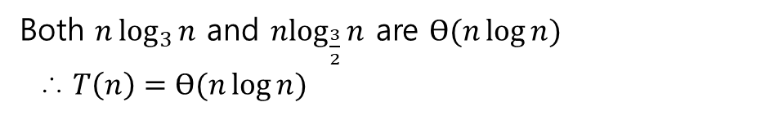
3. Recursion Tree
The recursion tree has the following shape:
Lower bound by
$$n\log_{3}{n}$$
Upper bound by $$n\log_{\frac{3}{2}}{n}$$
Both $n\log_{3}{n}$ and $n\log_{\frac{3}{2}}{n}$ are $Ɵ(n\log{n})$
∴ $T\left(n\right)=Ɵ(n\log{n})$
*Recursion trees can also be used to make an educated guess for method no.2

Slide 7









4. Master Theorem
The master theorem gives a generalized rule for solving recursions of the following form:
The recursion tree looks like this:
$$T\left(n\right)=aT\left(\frac{n}{b}\right)+cn^{k}$$
$$n$$
$cn^{k}$ ∵a problem of size takes $cn^{k}$ time
…$\frac{n}{b}$ $\frac{n}{b}$ $\frac{n}{b}$…
$$ac{\left(\frac{n}{b}\right)}^{k}$$
$$a$$
…$\frac{n}{b^{2}} \frac{n}{b^{2}} \frac{n}{b^{2}}$…
$$a^{2}c{\left(\frac{n}{b^{2}}\right)}^{k}$$
$$a^{2}$$
Layer $i$ costs $a^{i}c{\left(\frac{n}{b^{i}}\right)}^{k}$ which could be rearranged to $cn^{k}{\left(\frac{a}{b^{k}}\right)}^{i}$

Slide 8
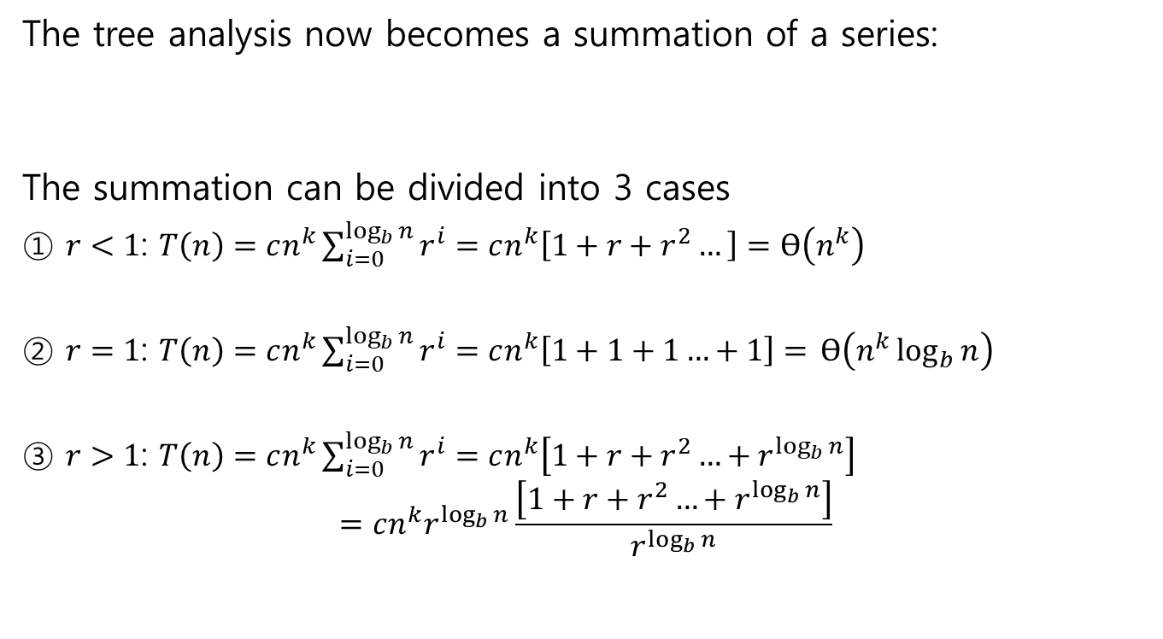
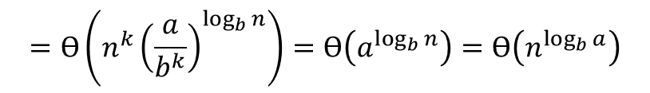

4. Master Theorem
The tree analysis now becomes a summation of a series:
The summation can be divided into 3 cases
① $r<1$: $T\left(n\right)=cn^{k}\sum_{i=0}^{\log_{b}{n}}{r^{i}}=cn^{k}\left[1+r+r^{2}…\right]=Ɵ\left(n^{k}\right)$
② $r=1$: $T\left(n\right)=cn^{k}\sum_{i=0}^{\log_{b}{n}}{r^{i}}=cn^{k}\left[1+1+1…+1\right]=$ $Ɵ\left(n^{k}\log_{b}{n}\right)$
③ $r>1$: $T\left(n\right)=cn^{k}\sum_{i=0}^{\log_{b}{n}}{r^{i}}=cn^{k}\left[1+r+r^{2}…+r^{\log_{b}{n}}\right]$ $$=cn^{k}r^{\log_{b}{n}}\frac{\left[1+r+r^{2}…+r^{\log_{b}{n}}\right]}{r^{\log_{b}{n}}}$$
$\sum_{i=0}^{\log_{b}{n}}{cn^{k}{\left(\frac{a}{b^{k}}\right)}^{i}=}cn^{k}\sum_{i=0}^{\log_{b}{n}}{{\left(\frac{a}{b^{k}}\right)}^{i}=}cn^{k}\sum_{i=0}^{\log_{b}{n}}{r^{i}}$, where $r=\frac{a}{b^{k}}$
Converges to a constant
$$\log_{b}{n}$$
constants
$$=Ɵ\left(n^{k}{\left(\frac{a}{b^{k}}\right)}^{\log_{b}{n}}\right)=Ɵ\left(a^{\log_{b}{n}}\right)=Ɵ\left(n^{\log_{b}{a}}\right)$$

